Slide 1



Hardware and Software Fundamentals of Intelligent Computing Systems

Slide 2
Lecture 14: Normalization and Activation Functions

Slide 3
Outline
Basic Analysis of Operator Optimization
Element-wise and Reduction Operations

Slide 4
GPU core metrics
Compute Power (FLOPS):
Refers to the number of floating-point operations a GPU can perform per second.
Thanks to more computing cores and higher clock frequencies, computing power is growing very rapidly.
Memory Bandwidth:
Refers to the total amount of data a GPU can read from or write to its global memory per second.
The growth rate of memory bandwidth lags far behind that of computing power, leading to the "Memory Wall" problem: GPU computing cores are often idle while waiting for data from slow memory.

Slide 5
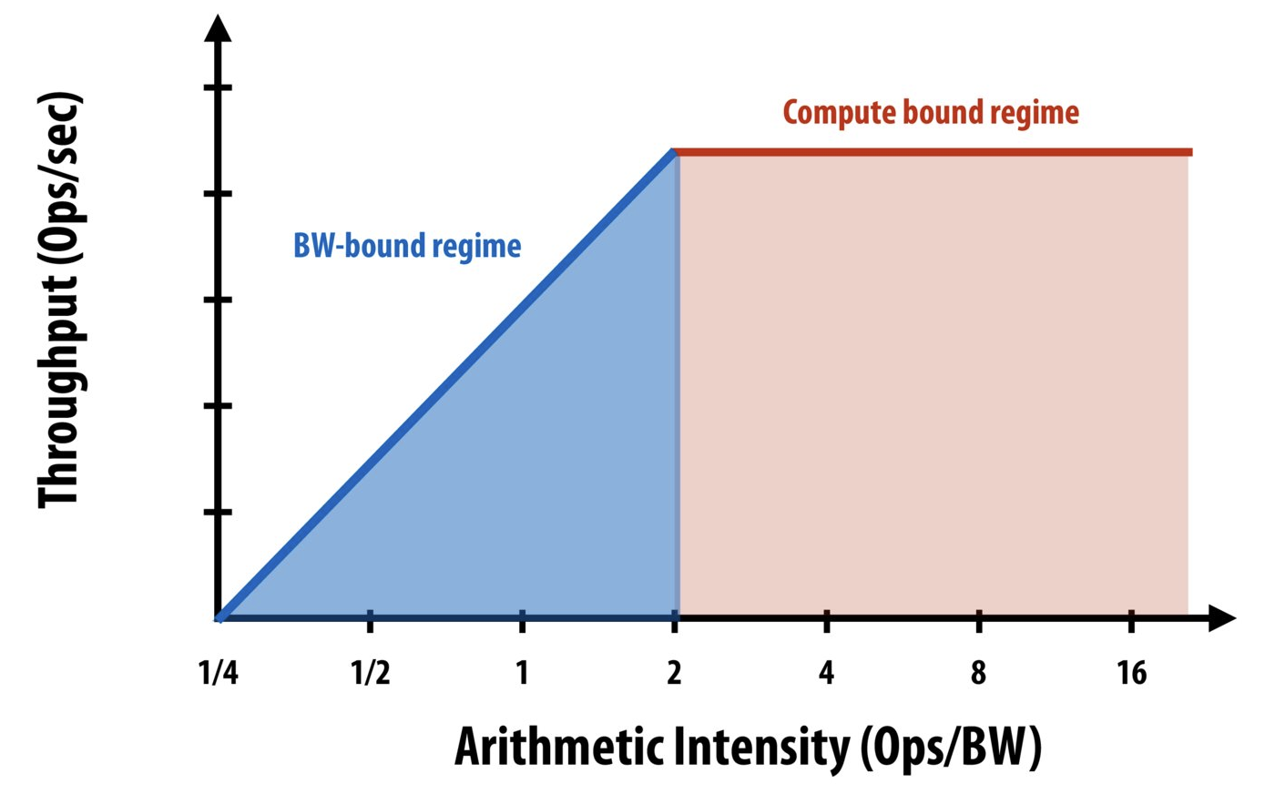
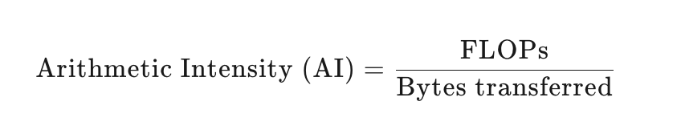
Roofline Model
Definition: The Roofline Model is an intuitive performance prediction model that analyzes the performance ceiling of specific operators on given hardware.

Slide 6
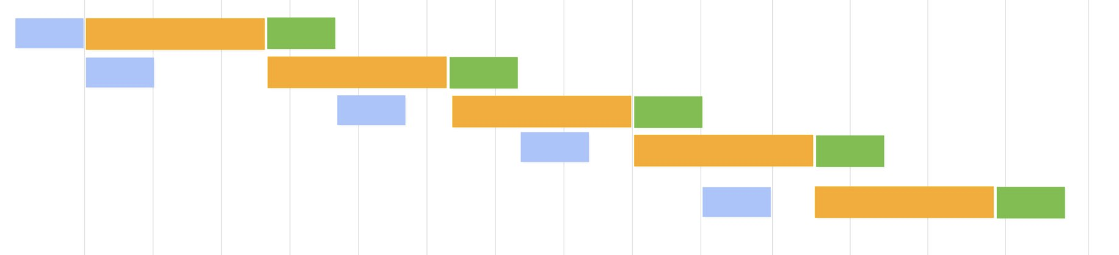
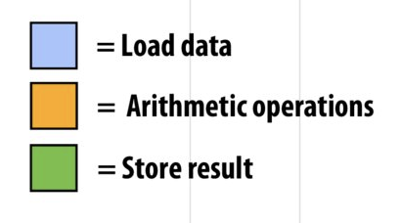
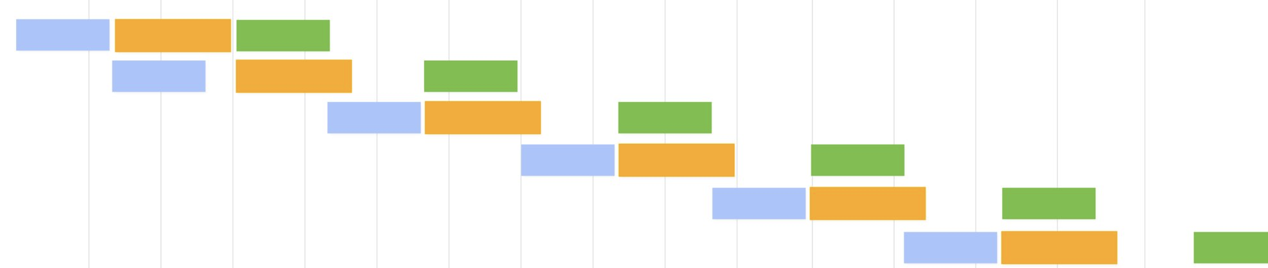
Operator Type
Compute-bound: Operator's computational load far exceeds data read/write operations. Examples include large matrix multiplication or multi-channel convolution. Performance depends mainly on GPU computational power.
Memory-bound: Operator's read and write operations far exceed the computational volume. For example, element-wise operations such as ReLU, Add, BatchNorm, and Dropout. Their performance mainly constrained by the memory bandwidth.

Slide 7
Outline
Basic Analysis of Operator Optimization
Element-wise and Reduction operations

Slide 8
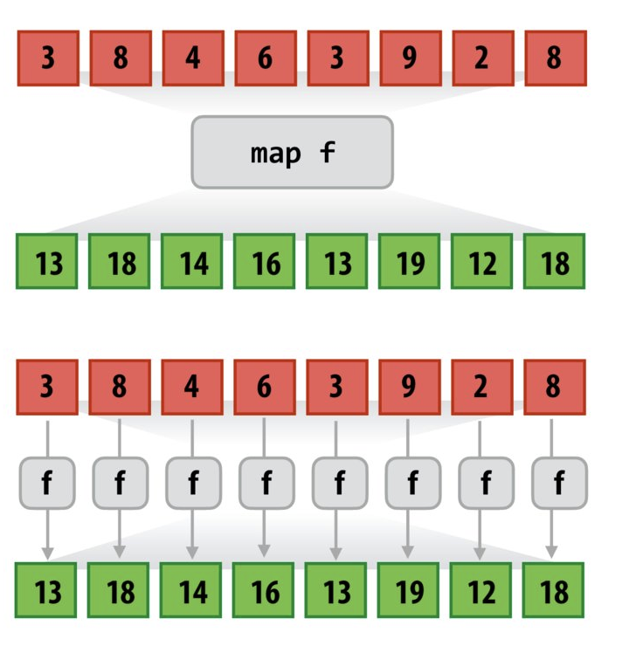
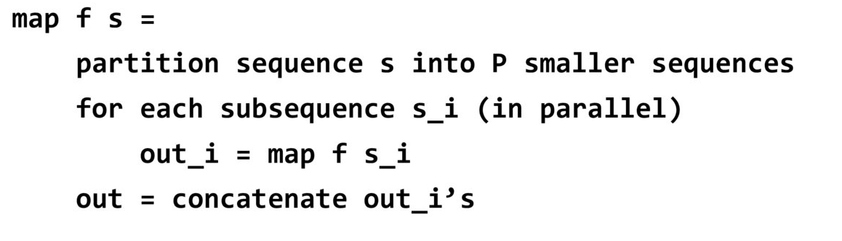
Element-wise
Core logic: Apply the same transformation independently to each element in the set without interference between elements
Parallelism: Since there are no dependencies between each computational branch f(x), it can be distributed across thousands of threads for concurrent execution.
GPU Friendly: Perfect Match for SIMD Execution Model

Slide 9
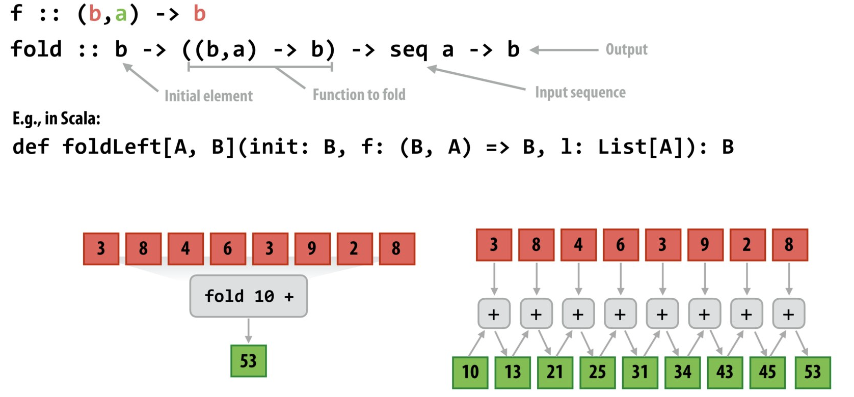
Reduction
Core logic: Combines multiple elements of a sequence into fewer results through a binary operation (e.g., Max)
Data flow: Each elements calculation depends on the cumulative result of the previous element

Slide 10
Element-wise vs Reduction
Core Difference Comparison
characteristic | Element-wise | Reduce (Tree)
Calculation mode | N ----> N | N ----> 1
Thread communication | Threads are completely independent | Data must be exchanged through Shuffle or Shared Memory
Triton function | Standard operators (+, -, *) | tl.sum, tl.max, tl.reduce
typical algorithm | ReLU, Vector Add, Dropout | LayerNorm, Softmax, Dot Product

Slide 11
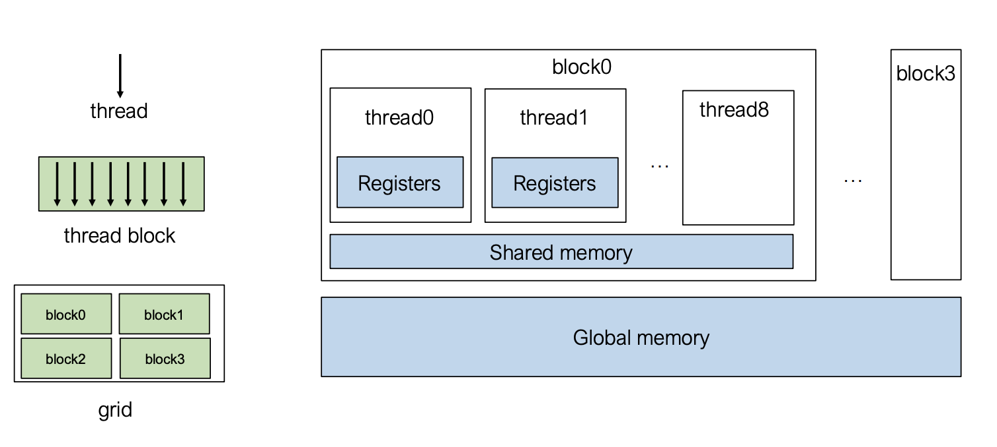
Review: GPU Memory Hierarchy
Thread level: Threads are organized into Blocks, which are assigned to the SM for execution.
Memory visibility: Global Memory is visible to all threads, while Shared Memory is visible only to threads within the same Block.
Register | Shared Memory | L2 Cache | HBM
64 KB 130TB/s | 227 KB 33 TB/s | 50MB 12TB/s | 80GB 3TB/s

Slide 12


Data Competition in Reduction Process
Consider a basic reduction: suppose the value in global memory is 3, and both threads want to increment it by 1.
Scenario 1:
Thread 1 reads value 3, adds 1, and writes 4 back to global memory
Thread 2 reads value 4 and writes 5 back to global memory
Situation 2:
Thread 1 reads value 3
Thread 2 reads value 3
Both threads operate on 3 and write the result 4 back to global memory

Slide 13
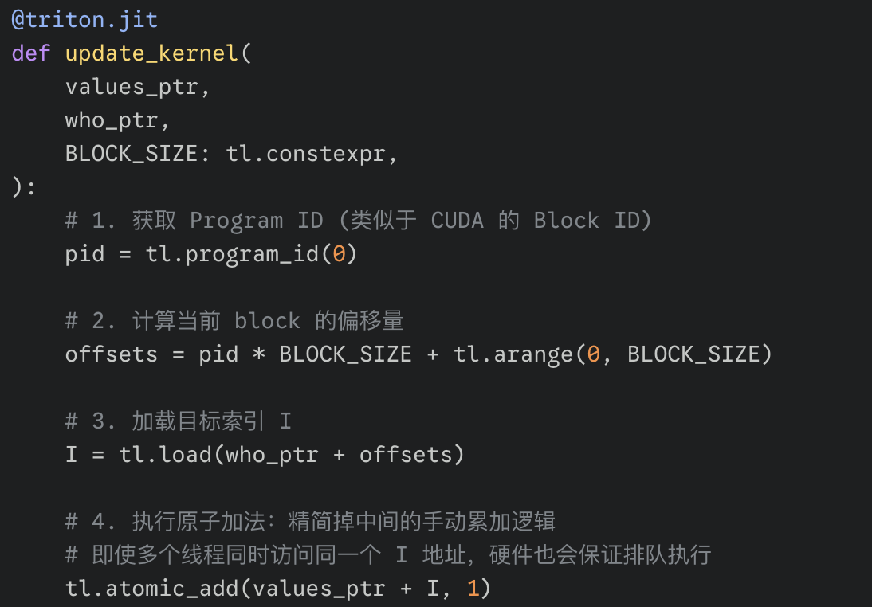
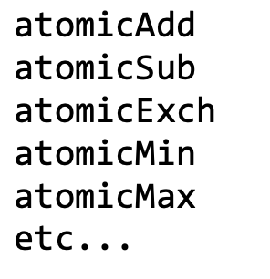
Solution: Atomic Operations
Core logic: Ensure this memory location is not accessed by other operations during execution
Although atomicAdd guarantees correct results, its performance is generally poor and is only suitable for sparse access.

Slide 14
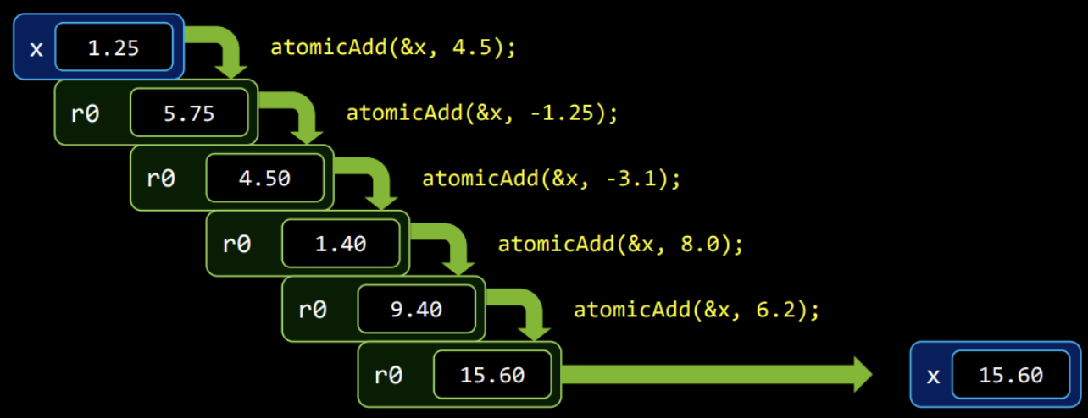
The Performance Bottleneck of Atomic Operations
Serialization occurs: The GPUs originally powerful parallel processing capability degrades to single-core serial performance.
Higher instruction overhead: Atomic operations require locking the memory location at the lower level to prevent the entire read-modify-write process from being interrupted by other Workers.

Slide 15
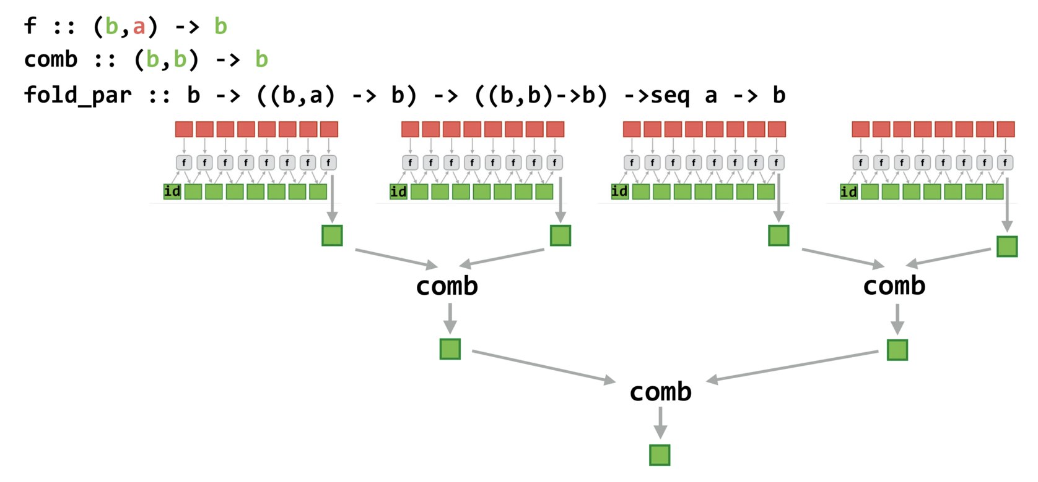
Reduction Parallelism
If the operation satisfies the associative property (e.g., a + (b + c) = (a + b) + c), it can be parallelized using a tree structure.
First, different Workers compute local reduction results, which are then combined by the Combiner function.
O(N)
O(logN)

Slide 16
reduced objective
Objective: Achieve optimal peak GPU performance
Bottleneck: Memory Access Bottleneck
Very low arithmetic intensity, with only one operation (e.g., addition) per loaded element
Ratio: 1 FLOP per Element
Conclusion: The optimization objective of reduction is to maximize bandwidth utilization
Notes:
单击此处添加文本

Slide 17
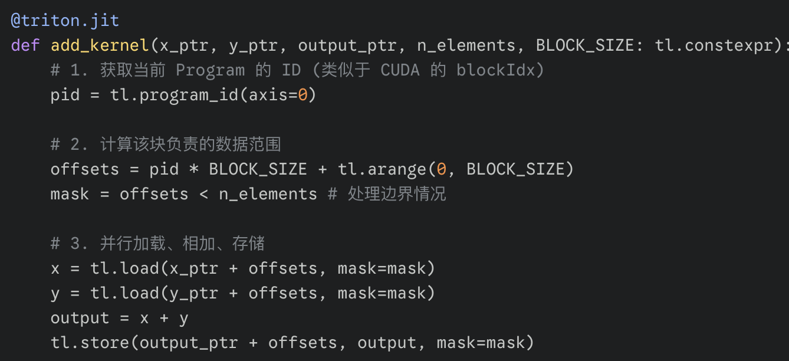
Triton example: vector addition
This is the simplest parallel mode: each thread processes one or more independent data points without needing to communicate with each other.

Slide 18
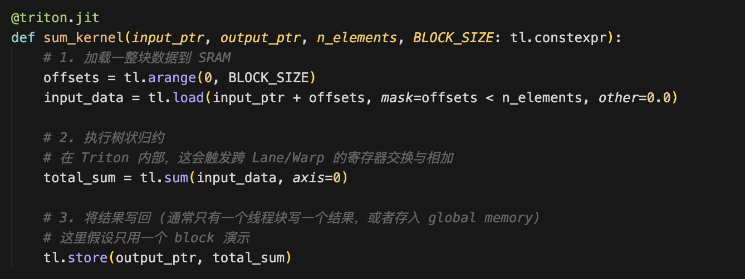
Triton example: Sum
Reduction is relatively more complex and requires a tree-like parallel structure. However, Triton abstracts the underlying tree-based exchange logic and encapsulates it within the tl.sum function, enabling direct invocation.

Slide 19
reduction of massive data
Question: How do different threads operate on separate SMs and share intermediate results?
ideal global synchronization
If CUDA supports Global Barrier:
All blocks sync automatically after the first round of reduction
Continue the recursive reduction until a single value is obtained
Why doesnt CUDA support global synchronization on the device side?
The hardware cost is prohibitively high: over 80 SMs,and if each supports multiple resident blocks, global synchronization requires massive hardware logic.
Deadlock risk: If the number of blocks initiated by the programmer exceeds the GPUs concurrent execution capacity (SM × number of resident blocks per SM), some blocks may be suspended. If running blocks wait for synchronization from suspended blocks, a deadlock may occur.

Slide 20
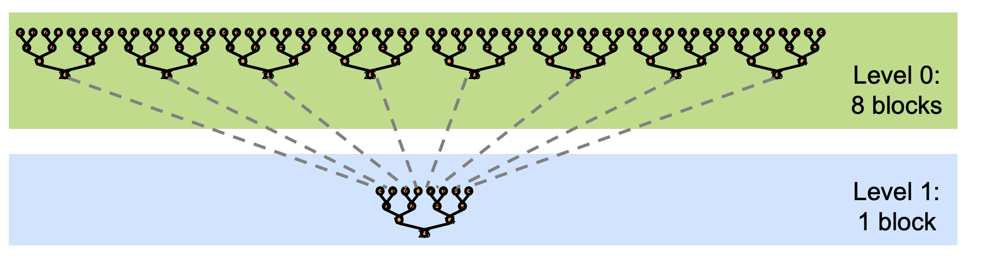
Solution: Kernel Decomposition
Since synchronization cannot be performed within the Kernel, we can achieve it by terminating the Kernel. The end of the Launch process naturally serves as a global synchronization point.
Multi-level reduction:
Level 0: Launch a large number of Blocks, each reducing a portion of the data, and write the results to global memory
Level 1: Start a small number of Blocks and read the Level 0 results for secondary reduction

Slide 21
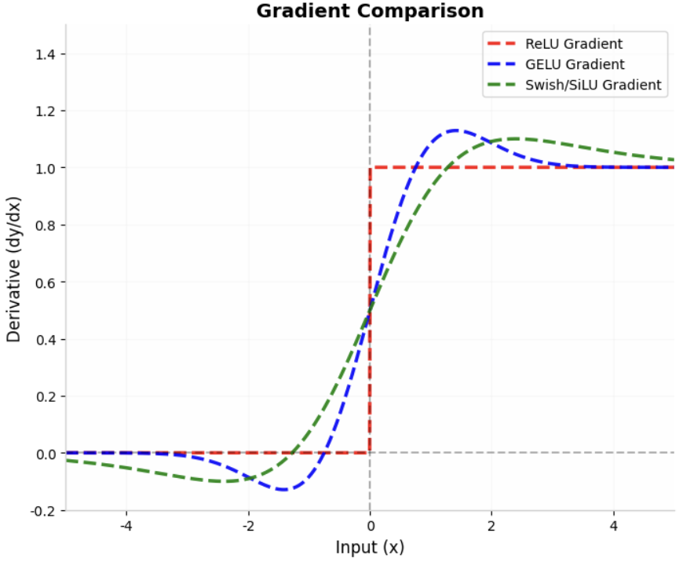

activation function
Definition: Introduces nonlinear capabilities to neural networks, enabling the model to fit complex function mappings.
Take GELU as an example
computational formula ：
Due to the inclusion of transcendental functions, the computational intensity is high. When executed independently, it is constrained by memory bandwidth. However, when integrated with GEMM, the complex erf calculations significantly reduce kernel latency.

Slide 22
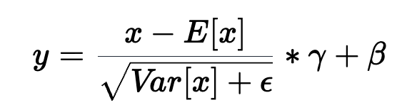
LayerNorm
LayerNorm is a core component of modern neural networks like Transformers, whose core idea is to normalize all features of a single sample.
Formula: For the input x, the output y is
Computational dependencies: Calculating mean and variance requires traversing the entire row of data, which is essentially a Reduction operation.

Slide 23

The Solution: FlagOS, a Unified AI Software Stack

Slide 24








https://space.bilibili.com/3546791834290849
https://github.com/flagos-ai
https://www.zhihu.com/people/95-22-20-18/posts
https://flagos.io/Home

Slide 25

Thanks for your time！

